Slide 1
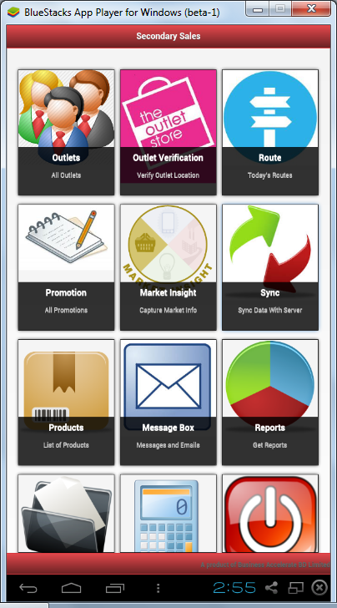
Modules
Outlets List
New Outlet
Route (sales order collection)
Sales Order Delivery
Promotions
Market Insight
Products
Focused Products
Sync/Auto sync
Calculator
Message
Reports
Delivery Module

Slide 2
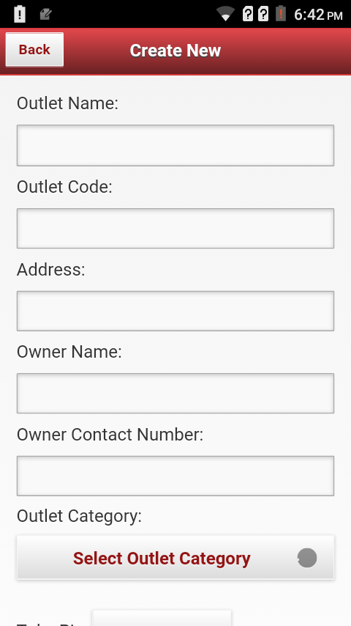
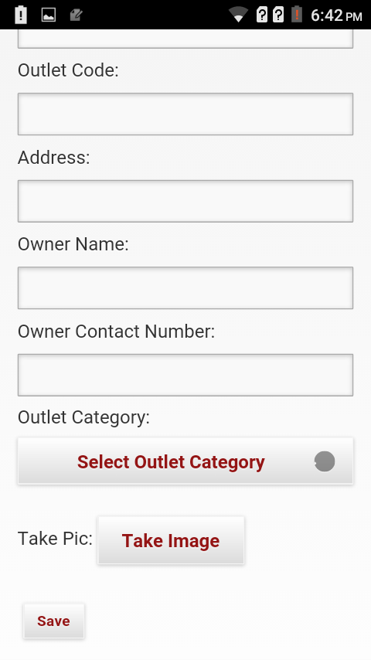
New Outlet Creation
Add on Fields
Grade
A/B/C/D
Channel
Outlet Type
Exclusive/ Nonexclusive
Visi-coolar
Non Mandatory Fields: Owner name, contact number and visi-cooler.

Slide 3
Promotions APK View (PSR)
Promotions Detailed View
SL | SKU | Promotion Name | Promotion Description | Start and End Date

Slide 4
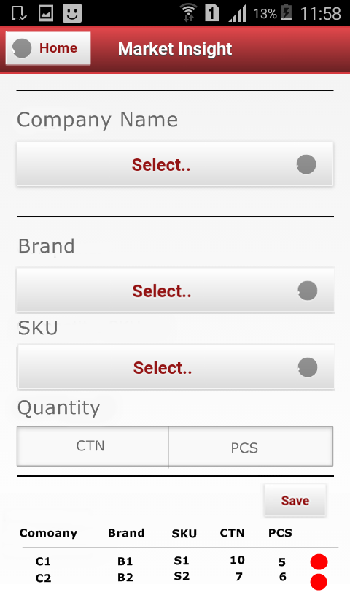
Market Insight
Tertiary
SKU | Opening | Purchase | Closing
SKU-1
SKU2
Next Visit Input
CS
Configuration part will be in MIS part just like existing system
Visicular
Visicular IMAGE
Outlet MAGE
CS

Slide 5
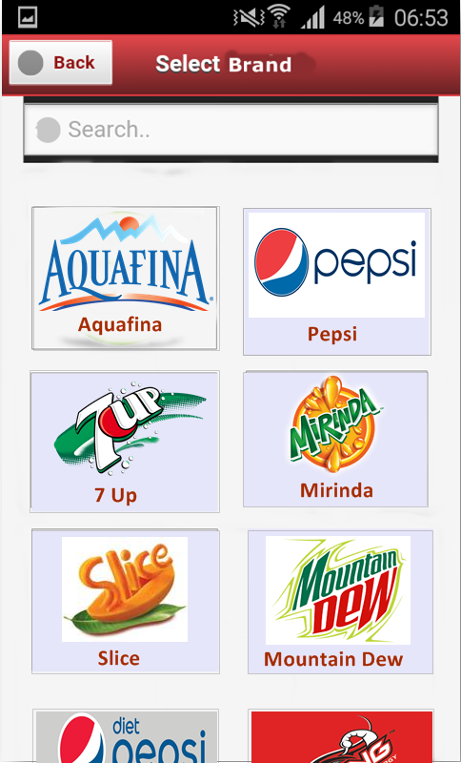
Product List UI
All Products
Brands
All Products
Brands
SL | Brand | Sub Brand | SKU Code | SKU Name(short) | Price (TP price pieces)

Slide 6
Focused Products
SL | Brand | Sub Brand | Full SKU Name | Date Range
Description:
MIS will input Focused Products sales GEO wise to the PSR(DB).
PSR will see their FP while login notification and from APK view, there is a separated module called FOCUSED PRODUCT and this list view look alike this window.
In the MIS/DB dashboard report view there is a
Configuration will be in MIS view.

Slide 7
National
 | Pepsi 200ML | SKU2 | SKU3 | SKU4 | SKU5
Unit1 | 1
Unit2 | 1
Unit3 | 1
Unit4 | 1
Total | 4
Unit
 | SKU1 | SKU2 | SKU3 | SKU4 | SKU5
TDM1
TDM2
TDM3
TDM4
Total
TDM
 | SKU1 | SKU2 | SKU3 | SKU4 | SKU5
CE1
CE2
CE3
CE4
Total
CE
 | SKU1 | SKU2 | SKU3 | SKU4 | SKU5
DB1
DB2
DB3
DB4
Total
DB
 | SKU1 | SKU2 | SKU3 | SKU4 | SKU5
PSR1
PSR2
PSR3
PSR4
Total
Description:
DB>CE>TDM>Uint>National dashboard report view of Focused Producs for date range.

Slide 8
Sales Delivery
Outlet Wise Sales
Select Date
Outlet
Address
Route
Route>Sub-Route
Sub-Route
Create New Sales Order
SKU Code | SKU | QTY (CS&PCS) |  | Value
 |  | CS | PCS
 |  |  |  | Add/Delete
SL | Outlet Code | Outlet Name | QTY (CS & PCS) Collumn | Amount | Status
 |  |  |  |  | New/Closed
Dues
Cash
GRB(CS & PCS
Crate
Auto rcv
Auto rcv
Auto rcv
Save
Deliver
Description:
PSR enter this module from APK. By this time these DB sales orders will also be managed fro DB login system.
To see the sales orders PSR selects particular date then rout and sub-rout to view all the collected sales orders.
PSR can select multiple sales orders from check box and can deliver at a time. PSR can also edit sales orders before delivery(at new status.
To edit sales orders PSR enters into the sales order and can add or edit SKU.
Cash, GRB and Crate dues will be auto calculated.
PSR will create previous days sales order if needed.

Slide 9
Auto Sync
Sales order, outlet collection in offline to online syncing will be automated. i.e whenever system finds any network, it will sync automatic.

Slide 10
For of Off Line View
KPI
SKU wise Sales
Date Range
Date Range
Route / Sub-Route
Route / Sub-Route
Schedule Call
Number of Memo
TLSD
LPSC
Target [CS]
Sales [CS]
Strick Rate
Achievement %
Drop Size
All product / All Brand / Selected Brand/ Selected SKU
Total Sales
SKU Name | CS/PS
PEPSI200mlGRB | 10CS-4PS

Slide 11
For of On Line View
KPI
Target vs Achievement
Order vs Delivery ()
Date Range
Date Range
Date Range
Route / Sub-Route
Route / Sub-Route
Route / Sub-Route
Schedule Call
Number of Memo
TLSD
LPSC
Target [CS]
Sales [CS]
Strick Rate
Achievement %
Drop Size
Target [CS]
Sales [CS]
Achievement %
Remaining Target [CS]
Order [CS]
Delivery [CS]
Outlet name | Order [CS] | Delivery [CS]

Slide 12
For of On Line View
No Buyer
SKU wise Sales
Outlet Wise and SKU wise Sales
Date Range
Date Range
Date Range
Route / Sub-Route
Route / Sub-Route
Route / Sub-Route
Total Non-Buyer
All product / All Brand / Selected Brand/ Selected SKU
Outlet Name | SKU Name | CS/PS | Total
Rahim GS | PEPSI200mlGRB | 10CS-4PS | 15.04CS
 | 7UP1LPET | 5CS-2PS
Rana GS | PEPSI2LPET | 10CS-4PS | 15.04CS
 | 7UP1LPET | 5CS-2PS
Sub-Route Name | Outlet name
Total Sales
SKU Name | CS/PS
PEPSI200mlGRB | 10CS-4PS

